Slide 1
Module 5: JDBC & SQL Basics Java Database Connectivity + Relational Database Fundamentals
A BPI Training Program
‹#›

Slide 2
Objectives
Module Objectives:
By the end of this course, students will be able to:
Understand the fundamentals of relational databases.
Create, read, update, and delete data using SQL commands.
Design tables with proper primary and foreign key constraints.
Perform table joins and filtering queries for data analysis.
Connect Java applications to PostgreSQL database using JDBC.
Execute SQL queries from Java programs using Statement and PreparedStatement.
Handle JDBC exceptions and manage database resources efficiently.
Implement simple database-driven Java applications.
Notes:
‹#›

Slide 3
Introduction to Databases
Notes:
‹#›

Slide 4
SQL Basics
What is a Database?
A database is a structured collection of data
It stores data in a way that is:
Organized
Efficient
Easy to access
Databases are managed by a software called DBMS
Notes:
‹#›

Slide 5
SQL Basics
What is a DBMS?
DBMS = Database Management System
Software that:
Stores data
Retrieves data
Updates data
Protects data
Example:
MySQL
PostgreSQL
Oracle
MSSQL
Notes:
‹#›

Slide 6
SQL Basics
How Data is Organized?
Databases organize data using:
Tables → main storage units
Rows (Records) → individual entries
Columns (Fields) → data attributes
Notes:
‹#›

Slide 7
SQL Basics
Notes:
‹#›

Slide 8
SQL Basics
What is SQL?
Stands for Structured Query Language
Used for creating, accessing and managing data in a database.
Notes:
‹#›

Slide 9
SQL Basics
SQL Categories
1. DDL – Data Definition Language
CREATE
ALTER
DROP
2. DML – Data Manipulation Language
INSERT
UPDATE
DELETE
3. DQL – Data Query Language
SELECT
Notes:
‹#›

Slide 10
SQL Basics
SQL Table Creation
Common Constraints
PRIMARY KEY - unique identifier
AUTO_INCREMENT / SERIAL - automatically generates ID values
NOT NULL - cannot be empty
UNIQUE - no duplicate values
CREATE TABLE students (
id SERIAL PRIMARY KEY NOT NULL,
name VARCHAR(50) NOT NULL,
age INT,
email VARCHAR(100) UNIQUE
);
Notes:
‹#›

Slide 11
SQL Basics
SQL Table Creation
Common Constraints
FOREIGN KEY – links this table to another table
CREATE TABLE courses (
id SERIAL NOT NULL,
student_id INT,
course_name VARCHAR(50),
grade VARCHAR(2),
PRIMARY KEY (id),
FOREIGN KEY (student_id) REFERENCES students(id)
);
Notes:
‹#›

Slide 12
SQL Basics
Basic SQL Data Types
Type | Description
INT | Whole numbers
VARCHAR | Text
DATE | Date
DECIMAL | Money, prices
BOOLEAN | true or false
Notes:
‹#›

Slide 13
SQL Basics
SQL Commands (CRUD)
C - Create (INSERT)
R - Read (SELECT)
U - Update
D - Delete
Notes:
‹#›

Slide 14
SQL Basics
C - Create (INSERT)
Add new records
INSERT INTO students (name, age, email)
VALUES ('Juan Dela Cruz', 20, 'juan@example.com');
Notes:
‹#›

Slide 15
SQL Basics
R - Read (SELECT)
Retrieve data
With Condition:
SELECT name, age, email FROM students;
SELECT name, age, email FROM students WHERE age >= 18;
Notes:
‹#›

Slide 16
SQL Basics
U - Update
Modify existing data
UPDATE students
SET age = 22
WHERE id = 1;
Notes:
‹#›

Slide 17
SQL Basics
D - Delete
Remove records
DELETE FROM students WHERE age < 18;
Notes:
‹#›

Slide 18
SQL Basics
Filtering
WHERE, DISTINCT, ORDER BY
Notes:
‹#›

Slide 19
SQL Basics
Where Clause
The WHERE clause is used to select only rows that meet certain conditions
Syntax:
SELECT column1, column2
FROM table_name
WHERE condition;
Examples:
SELECT * FROM students
WHERE name = 'Maria Santos';
SELECT * FROM students
WHERE age BETWEEN 20 AND 22;
Notes:
‹#›

Slide 20
SQL Basics
Distinct
The DISTINCT keyword ensures that your result does not contain duplicate values.
Syntax:
SELECT DISTINCT column_name
FROM table_name;
Examples:
SELECT DISTINCT name FROM students;
Notes:
‹#›

Slide 21
SQL Basics
Order By
The ORDER BY clause sorts the results ascending (ASC) or descending (DESC).
Syntax:
SELECT column1, column2
FROM table_name
ORDER BY column1 ASC|DESC;
Examples:
SELECT * FROM students
ORDER BY age ASC;
SELECT * FROM students
ORDER BY name DESC;
Notes:
‹#›

Slide 22
SQL Basics
Exercise #1: Create a database and tables
Objective
Learn how to create a database, tables, and relationships in SQL.
Practice using primary key and foreign key
Students
id (primary key, not null)
name (varchar 50) (not null)
age (int)
email (varchar 100) (unique)
Exercise Steps
Create the database
Use SQL command to create training_db.
Switch to using the database.
Create the tables
Create students and courses tables.
Ensure primary keys, foreign keys, and constraints are applied.
Insert sample data
Add at least 5 students.
Add at least 3 courses.
Courses
id (primary key, not null)
student_id (int not null)
course_name (varchar 50 not null)
grade decimal (5,2)
student_id (foreign_key)
Notes:
‹#›

Slide 23
SQL Basics
JOINS
Joins allow you to combine data from multiple tables.
a) INNER JOIN
Returns rows that match in both tables
SELECT students.name, courses.course_name, courses.grade
FROM students
INNER JOIN courses ON students.id = courses.student_id;
b) LEFT JOIN
Returns all rows from left table, even if no match in right
SELECT students.name, courses.course_name, courses.grade
FROM students
LEFT JOIN courses ON students.id = courses.student_id;
Notes:
‹#›

Slide 24
SQL Basics
JOINS
c) RIGHT JOIN ( or RIGHT OUTER JOIN)
All rows from right table, even if no match in left
SELECT students.name, courses.course_name, courses.grade
FROM students
RIGHT JOIN courses ON students.id = courses.student_id;
d) FULL OUTER JOIN
All rows from both tables, matches where possible
SELECT s.id AS student_id, s.name AS student_name, c.course_name, c.grade
FROM students s
FULL OUTER JOIN courses c
ON s.id = c.student_id;
Notes:
‹#›

Slide 25
JDBC Overview
Notes:
‹#›

Slide 26
JDBC Overview
What is JDBC?
Java Database Connectivity (JDBC)
Standard Java API for working with databases
Provides drivers to communicate with DBs
Key components:
Driver
Connection
Statement / PreparedStatement
ResultSet
Notes:
‹#›

Slide 27
JDBC Overview
Why Do We Need JDBC?
Java alone cannot read/write database tables.
JDBC acts like a bridge between Java code and SQL databases.
It is database-independent — same Java code can work on MySQL, PostgreSQL, Oracle, etc. (with different drivers).
Notes:
‹#›

Slide 28
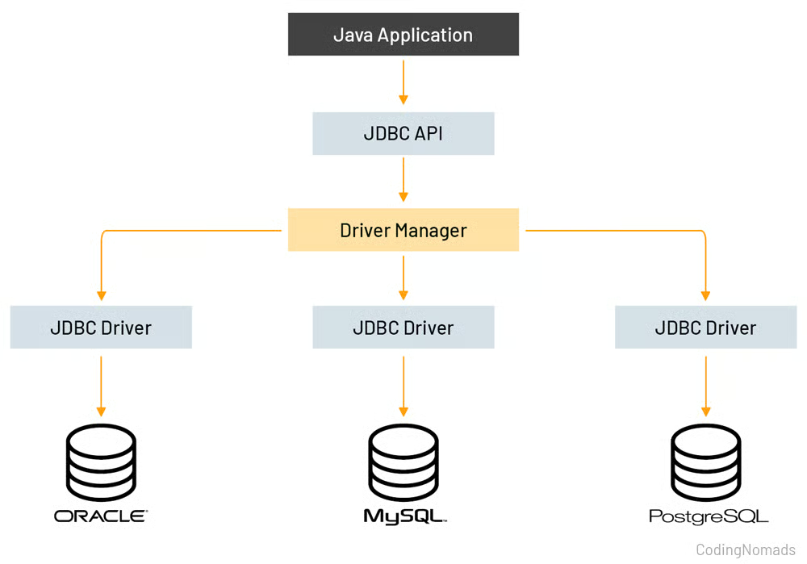
JDBC Overview
What is JDBC Architecture
Describes how Java communicates with a database using set of layers
Notes:
‹#›

Slide 29
JDBC Overview
Main Layers of JDBC
JDBC API
This is what Java developers use to communicate with the the database
Includes classes & interfaces like:
Connection - Represents an active link to database
Statement / PreparedStatement - For sending / executing SQL queries
ResultSet - Holds data returned from a query
DriverManager - Loads the database driver
Notes:
‹#›

Slide 30
JDBC Overview
Main Layers of JDBC
JDBC Driver
This is the translator between Java and the specific database
Examples:
MySQL → MySQL JDBC Driver PostgreSQL → PostgreSQL Driver Oracle → Oracle Driver
Notes:
‹#›

Slide 31
JDBC Overview
Main Layers of JDBC
JDBC Driver
Each driver knows how to:
Accept JDBC calls
Convert them into database-specific commands
Send the results back to Java
Notes:
‹#›

Slide 32
JDBC Overview
How To Configure JDBC?
Pre-requisite:
Download JDBC Driver
Postgres: https://jdbc.postgresql.org/download/
Notes:
‹#›

Slide 33
JDBC Overview
How To Configure JDBC?
1. Add the JDBC Driver
Where / How to add it?
Using IDE (Eclipse/IntelliJ/NetBeans): Add to project libraries
Using Maven (recommended for beginners):
<!-- PostgreSQL Example -->
<dependency>
<groupId>org.postgresql</groupId>
<artifactId>postgresql</artifactId>
<version>42.7.8</version>
</dependency>
Notes:
‹#›

Slide 34
JDBC Overview
How To Configure JDBC?
2. Create a Database URL (JDBC URL)
jdbc:<database_type>://<host>:<port>/<database_name>
String url = "jdbc:postgresql://localhost:5432/training_db";
Notes:
‹#›

Slide 35
Java Collections Overview
How To Configure JDBC?
3. Set your username and password
String username = "postgres";
String password = "postgres";
Notes:
‹#›

Slide 36
JDBC Overview
How To Configure JDBC?
4. Connect to the Database
Connection conn = DriverManager.getConnection(url, username, password);
Notes:
‹#›

Slide 37
JDBC Overview
How To Configure JDBC?
5. Create a Statement
Statement stmt = conn.createStatement();
Notes:
‹#›

Slide 38
JDBC Overview
How To Configure JDBC?
6. Execute SQL Queries
Query example (SELECT):
Query example (INSERT, UPDATE, DELETE)
ResultSet rs = stmt.executeQuery("SELECT * FROM students");
int rows = stmt.executeUpdate("INSERT INTO students VALUES (1, 'John')");
Notes:
‹#›

Slide 39
JDBC Overview
How To Configure JDBC?
7. Process the Result
while (rs.next()) {
System.out.println(rs.getString("name"));
}
Notes:
‹#›

Slide 40
JDBC Overview
How To Configure JDBC?
8. Close Everything - ResultSet, Statement, Connection
rs.close();
stmt.close();
conn.close();
Notes:
‹#›

Slide 41
JDBC Overview
Exercise #2: Database Connection using JDBC (M5_ACTIVITY2)
Objective: Learn how to connect to a database using JDBC.
Tasks:
Create a Java class DBConnection.
Connect to a PostgreSQL database using:
DriverManager
URL, username, password
Print:
"Connected successfully" if successful
Error message if connection fails
Notes:
‹#›

Slide 42
JDBC Overview
Statement vs PreparedStatement
Notes:
‹#›

Slide 43
JDBC Overview
Statement
Syntax:
Statement is used to execute simple SQL queries without parameters.
Statement stmt = conn.createStatement();
ResultSet rs = stmt.executeQuery("SELECT * FROM students");
Key Points:
Used for static SQL queries.
Vulnerable to SQL Injection if user input is concatenated.
Every execution is compiled at runtime, can be slower for repeated queries.
Notes:
‹#›

Slide 44
JDBC Overview
PreparedStatement
Syntax:
PreparedStatement is used for parameterized SQL queries.
Pre-compiles SQL for repeated execution.
PreparedStatement pstmt = conn.prepareStatement("SELECT * FROM students WHERE age > ?");
pstmt.setInt(1, 18);
ResultSet rs = pstmt.executeQuery();
Key Points:
Safe against SQL Injection.
Better performance for repeated queries.
Can use ? placeholders for dynamic input.
Notes:
‹#›

Slide 45
JDBC Overview
Exercise #3: Practice Inserting and Selecting using JDBC
Objective: You are required to create a Java application that can:
Add a Student
Capture student details: name, age, email.
Store these details in a students table.
Add a Course
Assign a course to a specific student.
Capture course name and grade.
Store these details in a courses table.
Ensure that each course is linked to a valid student.
Display all Students
Show all student records with ID, Name, Age, and Email.
Display all Courses
Show all courses with ID, Course Name, Grade, and the Student Name enrolled.
Tip: Use JOIN to combine data from students and courses table
Notes:
‹#›

Slide 46
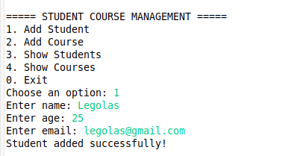
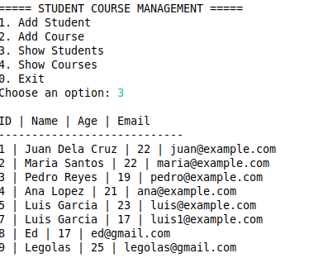
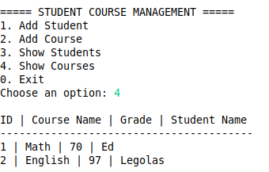
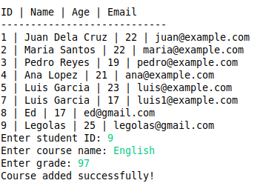
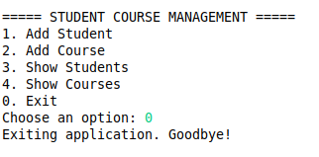
JDBC Overview
Notes:
‹#›

Slide 47
Best Practices with JDBC

Slide 48
JDBC Overview
Best Practices with JDBC
1. Use Proper Project Structure
src/
├── dao/ // Database access logic
├── model/ // POJOs / Entities
├── service/ // Business logic
├── util/ // Utilities
└── app/ // Main Application / entrypoint
Why?
Separation of concerns
Easier testing and maintenance
Prevents SQL code scattered everywhere (all are inside dao package)
Notes:
‹#›

Slide 49
JDBC Overview
Best Practices with JDBC
2. Centralize Database Configuration
public class DBConfig {
public static final String URL = "jdbc:postgresql://localhost:5432/training_db";
public static final String USER = "postgres";
public static final String PASSWORD = "password";
}
Why
Single place to update credentials
Cleaner and safer code
Notes:
‹#›

Slide 50
JDBC Overview
Best Practices with JDBC
3. Always use PreparedStatement
❌ Bad (SQL Injection risk)
String sql = "SELECT * FROM users WHERE username = '" + username + "'";
Statement stmt = conn.createStatement();
ResultSet rs = stmt.executeQuery(sql);
✅ Good
String sql = "SELECT * FROM users WHERE username = ?";
PreparedStatement ps = conn.prepareStatement(sql);
ps.setString(1, username);
ResultSet rs = ps.executeQuery();
Notes:
‹#›

Slide 51
JDBC Overview
Best Practices with JDBC
4. Handle Exceptions Properly
❌ Bad
catch (Exception e) {
System.out.println("Error");
}
✅ Good
catch (SQLException e) {
System.err.println("Database error: " + e.getMessage());
}
Notes:
‹#›

Slide 52
JDBC Overview
Best Practices with JDBC
5. Do Not Hardcode SQL Everywhere
❌ Bad
String sql = "INSERT INTO students VALUES (" + id + ",'" + name + "')";
✅ Good
private static final String INSERT_STUDENT =
"INSERT INTO students (id, name) VALUES (?, ?)";
Notes:
‹#›

Slide 53
JDBC Overview
Best Practices with JDBC
6. Validate Inputs Before Database Calls
if (name == null || name.trim().isEmpty()) {
throw new IllegalArgumentException("Name is required");
}
if (name.length() > 100) {
throw new IllegalArgumentException("Product name too long (max 100 chars)");
}
Why
Avoid unnecessary DB calls
Improves data integrity
Reduces SQL errors
Notes:
‹#›

Slide 54
JDBC Overview
Best Practices with JDBC
7. Avoid SELECT *
Why
Better performance
Clear intent
Prevents issues when table structure changes
❌ Bad
SELECT * FROM students;
✅ Good
SELECT id, name, email FROM students;
Notes:
‹#›

Slide 55
M5 Project
Your Task: Enhance your existing library system project using PostgreSQL database and JDBC
Technical Requirements
Enhance existing system to use PostgreSQL database + JDBC.
Use DAO pattern for BookDAO, LoanDAO, UserDAO.
Use PreparedStatement for all SQL queries.
Validate Inputs before database calls
Keep all application logic modular:
Entities/Models: Book, User, Loan
DAO Layer: database operations
Application Layer: menu handling and input
6. Handle exceptions properly. Use exception handling and logging as needed.
Additional Instructions:
Use your group’s Module 4 output as the code baseline.
Provide SQL scripts for: (push to Git)
Creating the database and tables.
Inserting initial sample data for books and users.
Collaborate effectively by assigning specific tasks to each group member.
Notes:
‹#›

Slide 56
M5 Project
[4] Borrow Book
Display all available books.
User selects a book by ID.
Create a Loan record in the database.
Mark the book as unavailable (is_available = false).
Validate: cannot borrow non-existent or already borrowed books.
[5] Return Book
Display all current loans.
User selects a loan by Loan ID.
Delete the Loan record from the database.
Mark the book as available (is_available = true).
Validate: cannot return non-existent loans.
[1] Display All Books
Show all books in the library (ID, Title, Author, Availability).
[2] Display Available Books
Show only books not currently borrowed (is_available = true).
[3] Display All Borrowed Books
Show books currently on loan.
Display Book Title, Borrower Name, Loan ID.
Notes:
‹#›

Slide 57
M5 Project
[8] Update Book
User inputs Book ID.
Cannot update books currently borrowed (is_available = false).
Update Title and/or Author.
Blank input retains old values.
[6] Add Book
User inputs Book ID, Title, Author.
Insert the book into the books table.
Default is_available = true.
Validate: cannot add duplicate IDs.
[7] Remove Book
User inputs Book ID.
Delete the book from the books table.
Delete any associated loan from the loans table.
Validate: cannot remove a non-existent book.
[0] Exit
Close database connections.
Stop the program.
Notes:
‹#›

Slide 58
THANK YOU!

